Slide 1

Telecom Customer Churn Prediction
Presented by Nour Kamaly

Slide 2

Global technology
Smart Product
Voice Recognition
Artificial Intelligence
VR

Slide 3
Uses of Virtual Reality

Slide 4
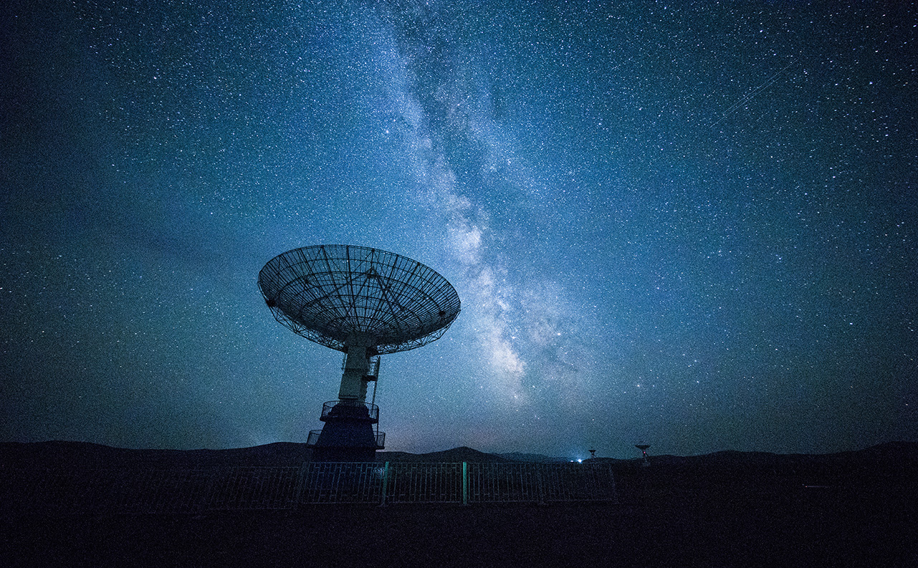
Network Technology
Problem Solving
Algorithm
Automation

Slide 5

Thank You!
nourkamaly26@gmail.com

